Slide 1
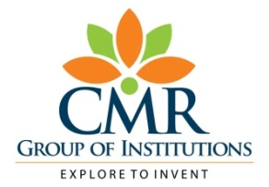

CMR TECHNICAL CAMPUS
(UGC AUTONOMOUS)
Accredited by NBA & NAAC with ‘A’ Grade
Approved by AICTE, New Delhi and JNTU, Hyderabad
Kandlakoya, Medchal Road, Hyderabad- 501 401, Telangana
ESTD: 2009
Department of CSE
Lung Cancer Prediction Using Deep Learning(DL)
Batch no.11
Project Coordinator:
Dr J. Narasimha Rao
Associate Professor, CSE Department
Project Guide:
G. Lavanya
(Assistant Professor, CSE Department)
Presented By:
G. Sruthi (217R1A05M8)
E. Pavani (217R1A05M5)
T. Nagalaxmi (217R1A05R0)

Slide 2
Contents
Abstract
Existing System
Disadvantages
Proposed System
Advantages of Proposed System
Hardware and Software Requirements
Novelty of project
Module
Diagrams
Output
Conclusion

Slide 3
Abstract
Early diagnosis plays a critical role in improving patient survival. Computer Aided Diagnosis (CAD) systems play an important role in identifying lung cancer from chest CT images by using techniques like image pre-processing, segmentation, feature extraction, and classification. Recently, hybrid deep learning models combining Convolutional Neural Networks (CNNs) and Recurrent Neural Networks (RNNs) have emerged, enhancing diagnostic accuracy by leveraging CNNs' strength in image feature extraction and RNNs' ability to capture temporal patterns. Deep learning, particularly using Python libraries like TensorFlow, Keras, and PyTorch, has shown promise in automating lung cancer prediction.

Slide 4
Existing System
Current systems for lung cancer detection mainly use traditional imaging techniques like chest X-rays and CT scans. While these methods are common in clinical settings, they often lack the sensitivity to detect lung cancer. Machine learning methods, such as support vector machines (SVMs) and decision trees, have been employed to analyze imaging data and patient records, improving diagnostic accuracy to some extent. However, they still face challenges with feature extraction and pattern recognition.

Slide 5
Disadvantages of Existing System
Low Sensitivity and Specificity
Manual Feature Extraction
Slow Processing Time
Limited Use of Advanced AI Techniques in Existing Systems
Many systems look at medical images and patient information separately.
CNNs are great at analyzing single images, but they aren’t good at looking at data that changes over time, like a patient’s medical history.

Slide 6
Proposed System
The proposed system introduces a new deep learning method to improve early lung cancer detection. It combines CNNs (which analyze detailed features from medical images like CT scans) with RNNs (which analyze patient data over time). This hybrid approach uses both image analysis and patient history to provide a more complete diagnosis. By doing so, it improves the system's ability to detect cancer accurately, even in early stages. Trained on a variety of data, the model adapts to different medical cases and offers real-time results, making it useful for doctors in diagnosing lung cancer faster and more accurately.

Slide 7
Advantages
Enhanced Accuracy
The system looks at both images (via CNNs) and patient history (via RNNs), giving a full picture of the patient's health.
Early Detection
System offering quick analysis to help doctors make timely decisions.
Time Saving
Adaptability

Slide 8
Hardware and Software Requirements
Hardware Requirements:
Processor - Pentium –IV
RAM - 4 GB (min)
Hard Disk - 20 GB
Software Requirements:
Operating System - Windows 7 Ultimate
Coding Language - python

Slide 9
Novelty of project
The novelty of this project lies in its innovative use of a hybrid deep learning model that combines the strengths of Convolutional Neural Networks (CNNs) and Recurrent Neural Networks (RNNs) to improve lung cancer detection. Unlike traditional methods that focus on either image analysis or patient data separately, this system:
Integrates Image and Patient Data
The system creates a more complete view of a patient's health by combining imaging data and patient health records.
User-Friendly Interface
It reduces the manual work.

Slide 10
Modules
Data Preprocessing Module
Feature Extraction with CNN Module
Sequence Learning with RNN Module
Classification Module
Evaluation Module
Deployment Module

Slide 11
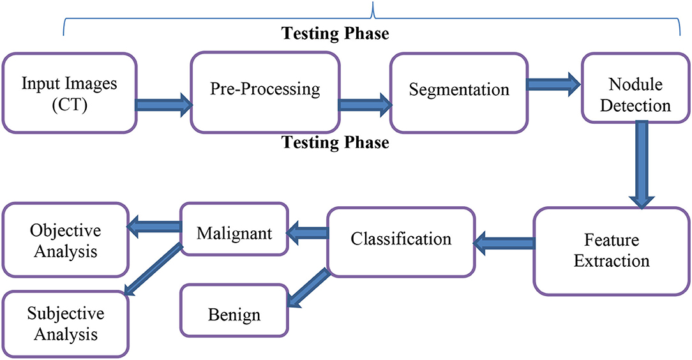
Architecture Diagram

Slide 12
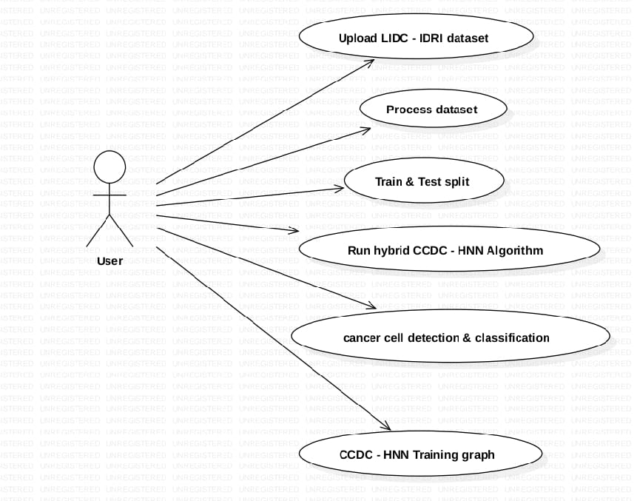
Usecase Diagram

Slide 13
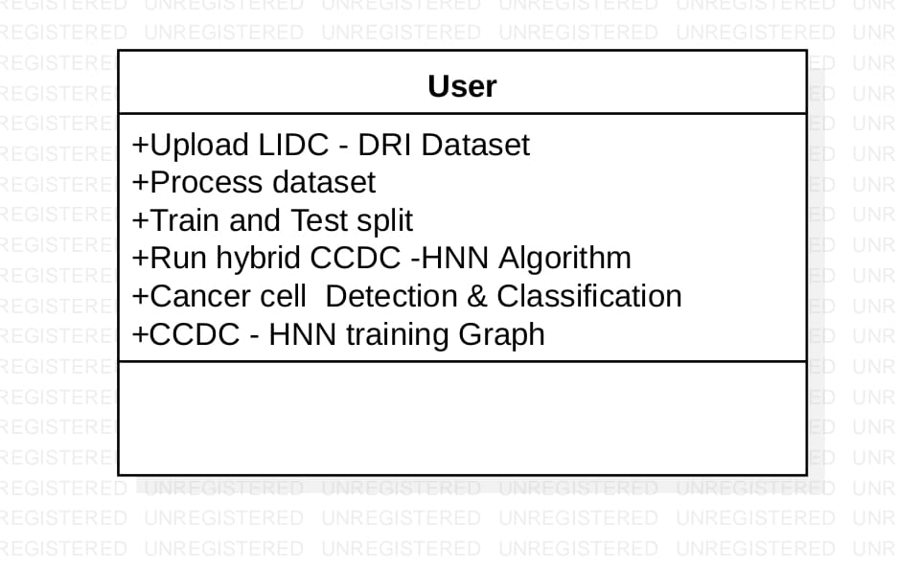
Class Diagram

Slide 14
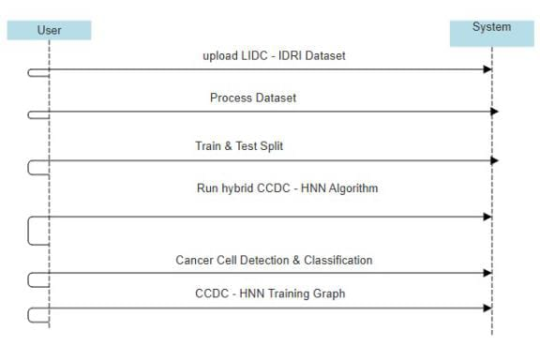
Sequence Diagram

Slide 15
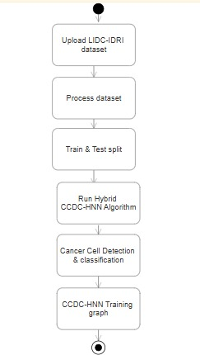
Activity Diagram

Slide 16
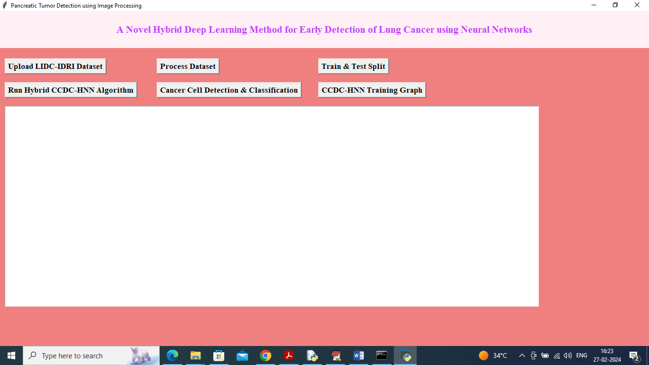
Output

Slide 17
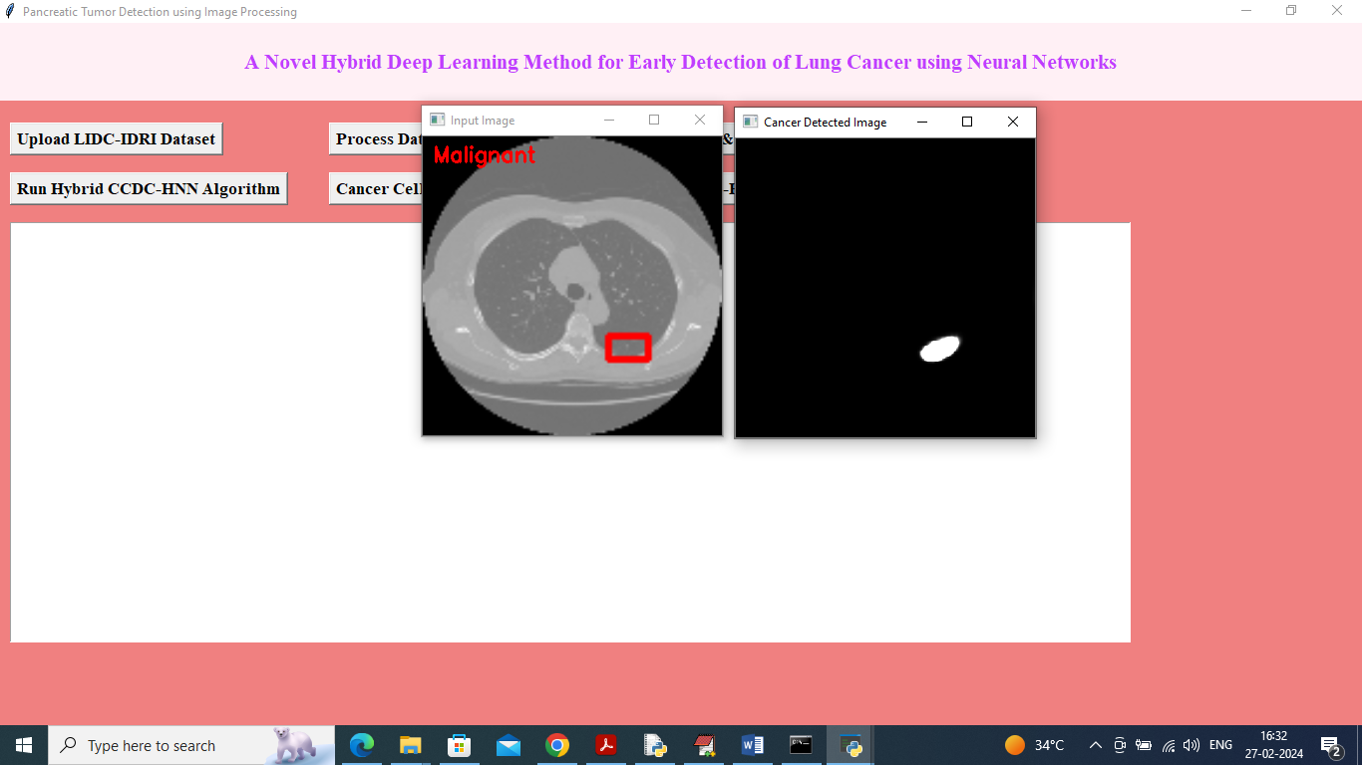

Slide 18
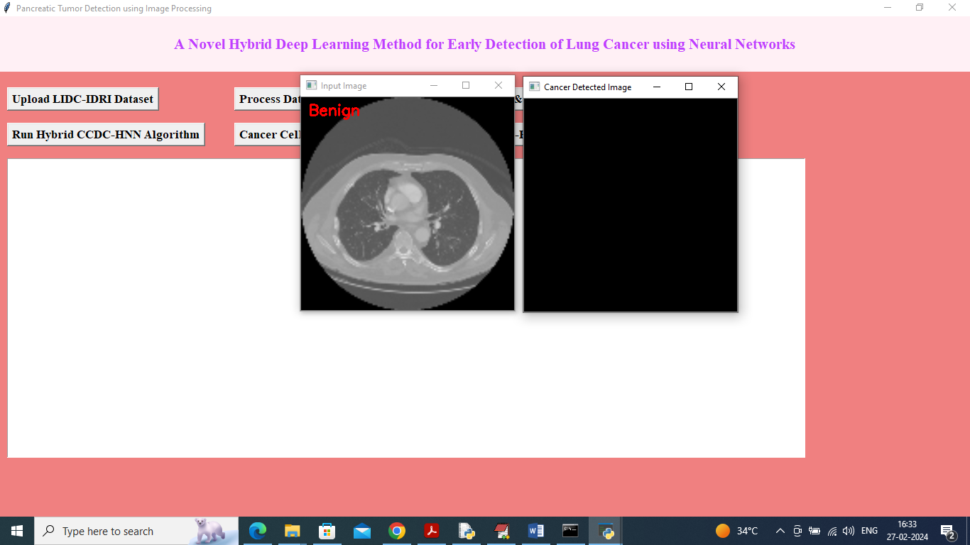

Slide 19
Sample Code
from tkinter import *
import tkinter
from tkinter import filedialog
import numpy as np
from tkinter import simpledialog
from tkinter import ttk
from tkinter.filedialog import askopenfilename
import cv2
import os

Slide 20
import numpy as np
#loading python require packages
import pandas as pd
import matplotlib.pyplot as plt
from sklearn.model_selection import train_test_split
from keras.models import *
from keras.layers import *
from keras.optimizers import *
from keras import backend as keras
from keras.preprocessing.image import ImageDataGenerator
from keras.callbacks import ModelCheckpoint, LearningRateScheduler
from keras.callbacks import ModelCheckpoint, LearningRateScheduler, EarlyStopping, ReduceLROnPlateau
from keras.optimizers import Adam
import pickle
from keras.callbacks import ModelCheckpoint
import pickle

Slide 21
import seaborn as sns
from sklearn.metrics import accuracy_score
from keras.models import Sequential
from keras.layers import Dense, Flatten, Dropout, Conv3D, MaxPooling3D, LSTM,RepeatVector
from keras.utils import to_categorical
from sklearn.metrics import roc_curve
from sklearn.metrics import roc_auc_score
from sklearn import metrics
from sklearn.metrics import precision_score
from sklearn.metrics import recall_score
from sklearn.metrics import f1_score
from sklearn.metrics import accuracy_score
from sklearn.metrics import confusion_matrix
global filename, X, Y
global X_train, X_test, y_train, y_test, unet_model, ccdc_model

Slide 22
Conclusion
The conclusion highlights that using both Convolutional Neural Networks (CNNs) and and Recurrent Neural Networks (RNNs) together creates a strong method for predicting lung cancer. CNNs are good at identifying important features from medical images like CT scans, while RNNs effectively for analyzing temporal patterns in patient history to determine the lung cancer. This combination improves the accuracy of lung cancer, which can lead to earlier diagnoses and better treatment plans for patients.

Slide 23
Future Scope
Lung cancer detection with deep learning is improving rapidly. In the future, we can expect:
More Accurate AI Models
Early Detection & Risk Prediction
3D Tumor Analysis & Monitoring
Remote Diagnosis & Telemedicine
AI in Surgery & Radiation Therapy

Slide 24
References
LeCun, Y., Bengio, Y., & Hinton, G. (2015). "Deep learning." Nature, 521(7553), 436-444. doi:10.1038/nature14539.
Goodfellow, I., Bengio, Y., & Courville, A. (2016). Deep Learning. MIT Press.
Ronneberger, O., Fischer, P., & Brox, T. (2015). "U-Net: Convolutional Networks for Biomedical Image Segmentation." Proceedings of the Medical Image Computing and Computer-Assisted Intervention (MICCAI), 234-241. doi:10.1007/978-3-319-24574-4_28.
GitHub Link

Slide 25
Thank You

